Slide 1
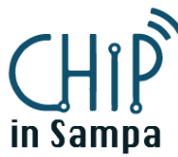
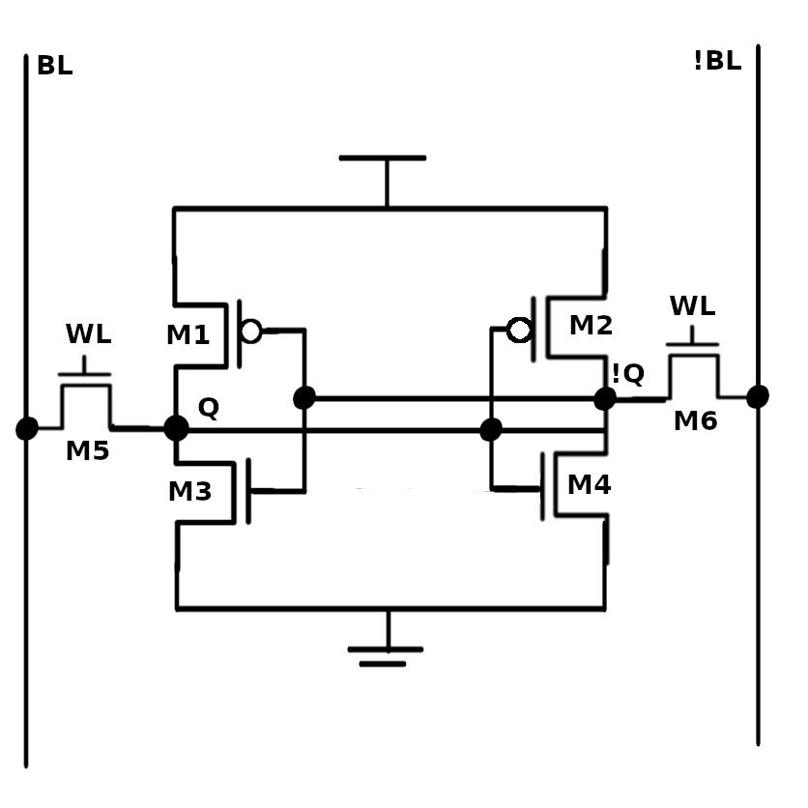
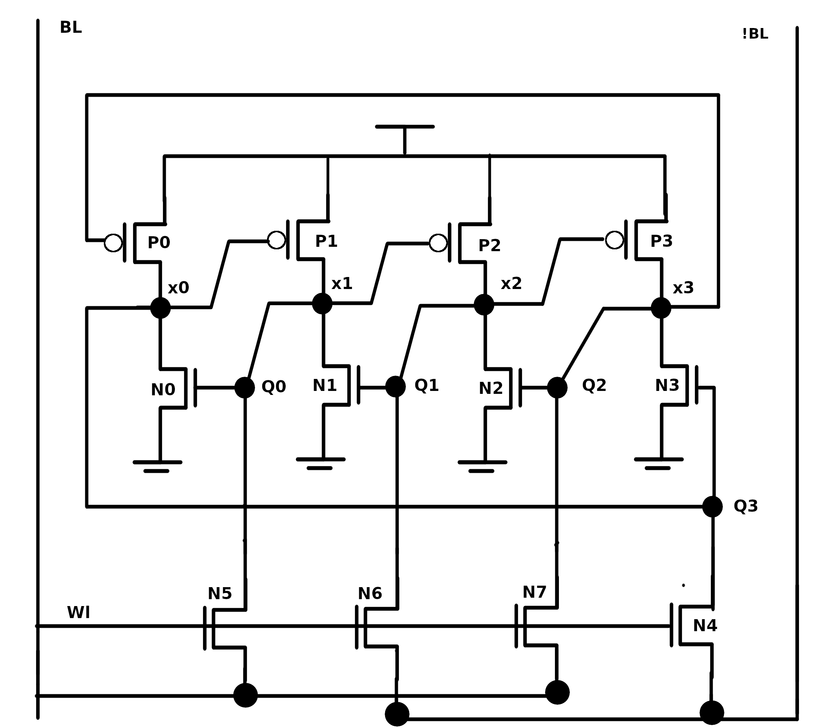
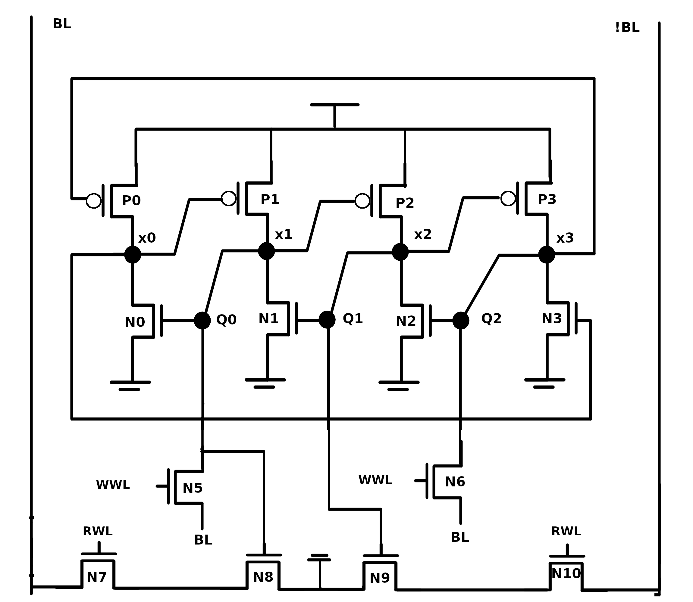
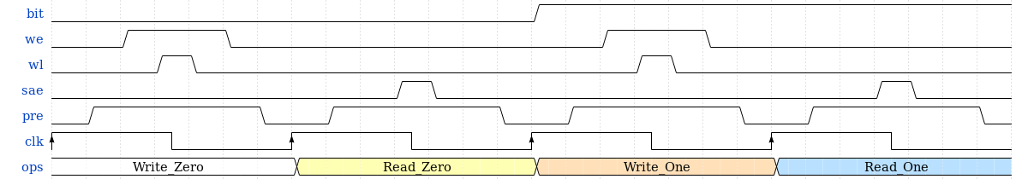
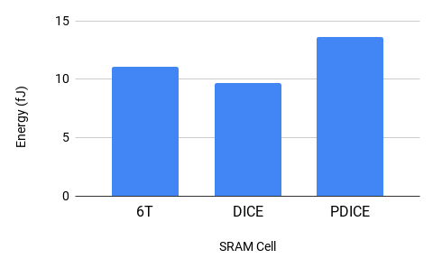
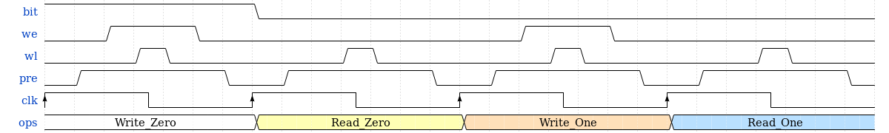
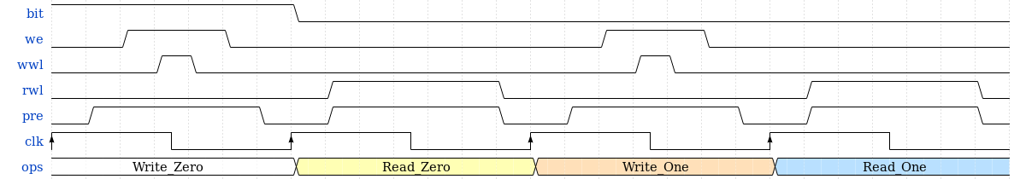
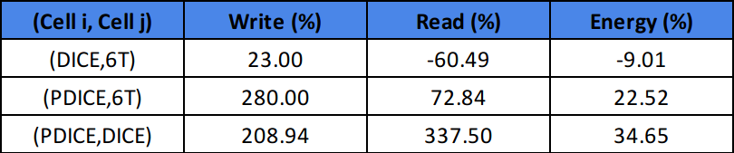
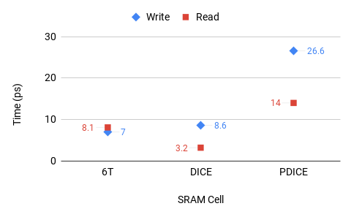




Evaluating Energy and Delay of DICE and DICE SRAM Cells at 32nm Technology
Maria Eduarda de Melo Hang, Cristina Meinhardt
Federal University of Santa Catarina - Brazil
Abstract: At nanometer nodes, with the reduced voltage due to technology scaling, soft errors due to cosmic rays can affect electronic devices even on earth. This work presents the design evaluation of two robust SRAM Cell, DICE and PDICE. These cells are recognized by the radiation robustness, however with a penalty on the transistor number and, consequently on the power and timing. After the simulations, DICE presents the lowest read time.
Motivation
2. SRAM Cells
To compare the new topologies DICE and PDICE, which are considered robust to radiation influence, against the 6T focusing in time of write and read, energy consumption and robustness.
Electrical Level Simulation NGSPICE;
Model of High Performance in 32nm (PTM);
Nominal voltage 0.9V.
6T
DICE
PDICE
(Wang, 2009)
(Wang, 2009)
3. Results
To measure the energy consumption and times, the order of operations was Write 0, Read 0, Write 1 and Read 1.
6T CELL
DICE
PDICE
6T SRAM obtained the shorter write time and a greater energy consumption than DICE.
TABLE I: Comparison between SRAM cells
DICE SRAM had a better power and performance than the others.
Compare (Ci,Cj) = [ ( Ci / Cj ) -1 ] * 100
4. Conclusion and Future Remarks
This work evaluates the electrical characteristics of the DICE and PDICE cells at 32nm technology. DICE cell shows good results compared with 6T traditional SRAM cell. Next steps include:
Measure the robustness and add the result;
Consider the Finfet and SOI Technologies;
PDICE was the worst.
August, 2019 São Paulo, SP
Contact: maria.eduarda.melo.hang@gmail.com

